Slide 1
Campus Parking Availability App
Group 8 - KLY Inc.
By: Mohammad Asif, Dylan Capece, Everett McCrea, Luke Padgett, Blake Stroud
Meeting times: Wednesdays at 6:20 pm - Google Hangouts video call

Slide 2
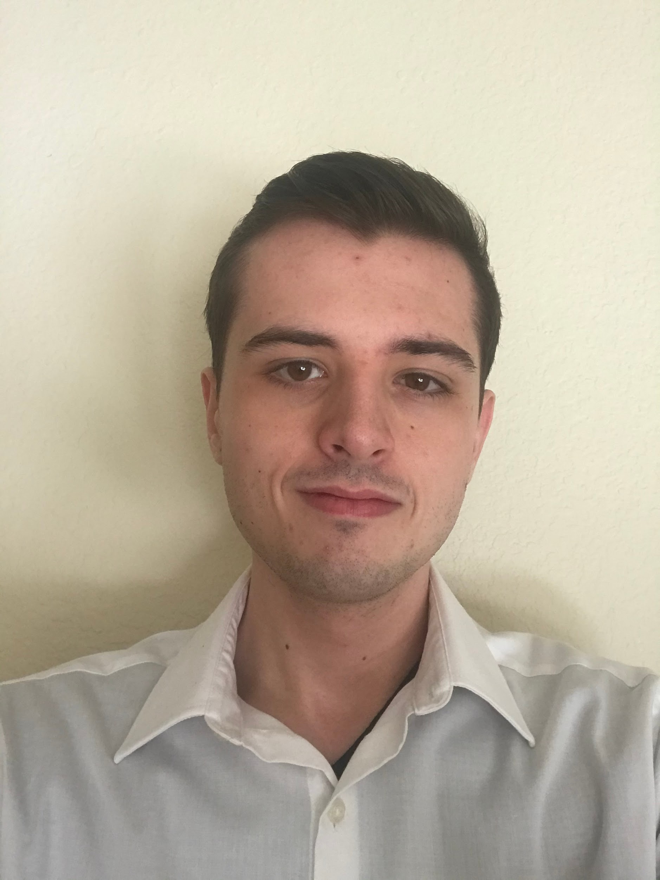
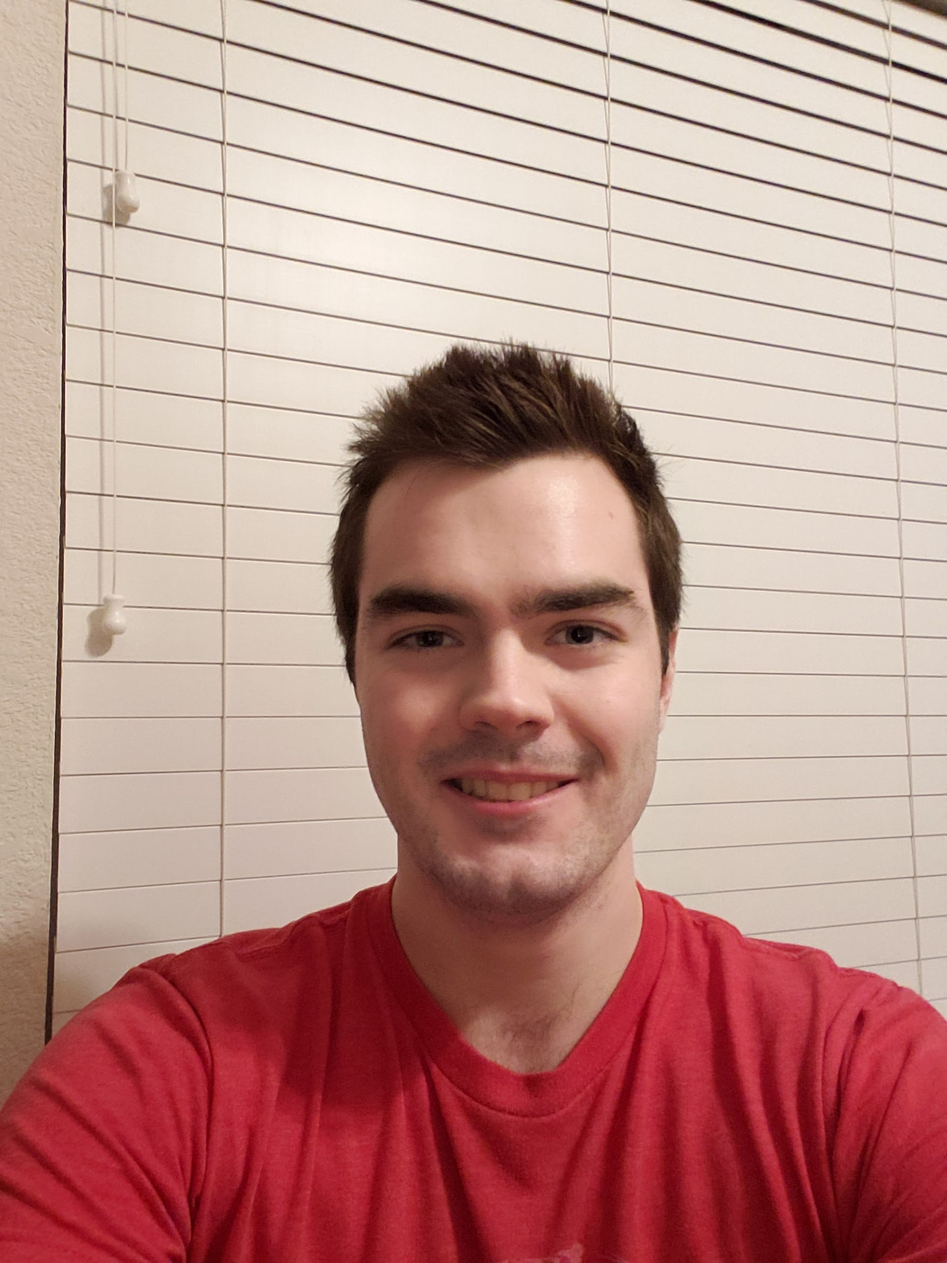

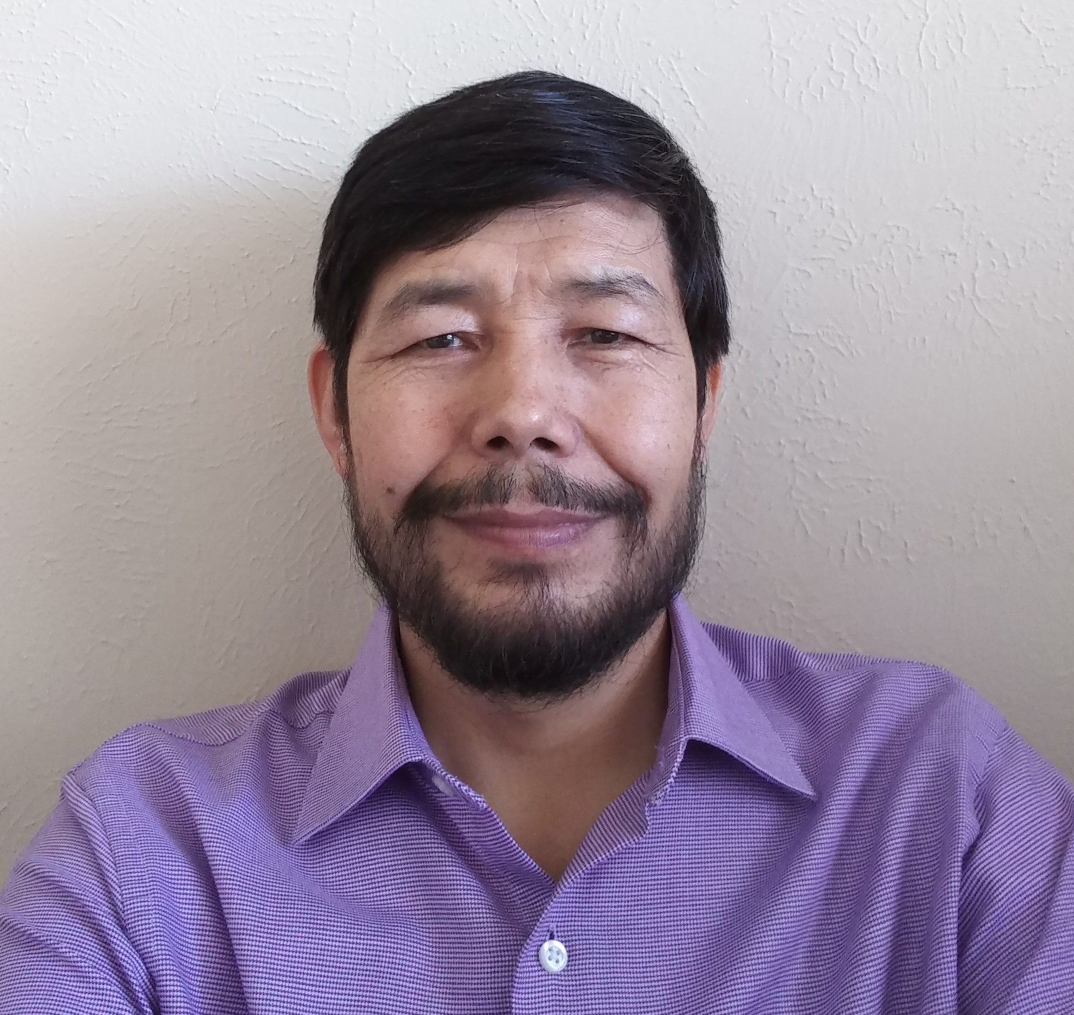

Everett McCrea
Software Engineering
Junior
Skills: Java, Cloud Computing
Job: Java Application Dev
Mohammad Asif
Software Engineering Junior
Skills: C++, Java
Job: Application Development
Luke Padgett Software Engineering Junior Skills: Java, Javascript
Job: Enterprise Java Dev
Dylan Capece
Software Engineering
Senior
Skills: Java, C++
Job: Application Development
Blake Stroud
Software Engineering
Senior
Skills: C++/C, Python
Job: Embedded Systems Engineer

Slide 3
Project Overview
App that shows real-time map of UTD parking availability
Track open spaces via car sensors and antennas at entrance of parking lot
Report number of cars in a lot to host system, then report to users
Track cars leaving parking lot
Detect which parking sticker cars have
Fix the UTD parking problem

Slide 4
Business Value
Save time and fuel
Less pollution
Increase end user satisfaction
Can charge a small fee
$2 a per week

Slide 5
Why Us
We have the necessary technical skills
Engineering and Computer Science majors
Motivated to fix a issue that affects us personally
Desire to improve the student experience
Knowledgeable of what the key issues are
Understand the potential that we can achieve with this service

Slide 6
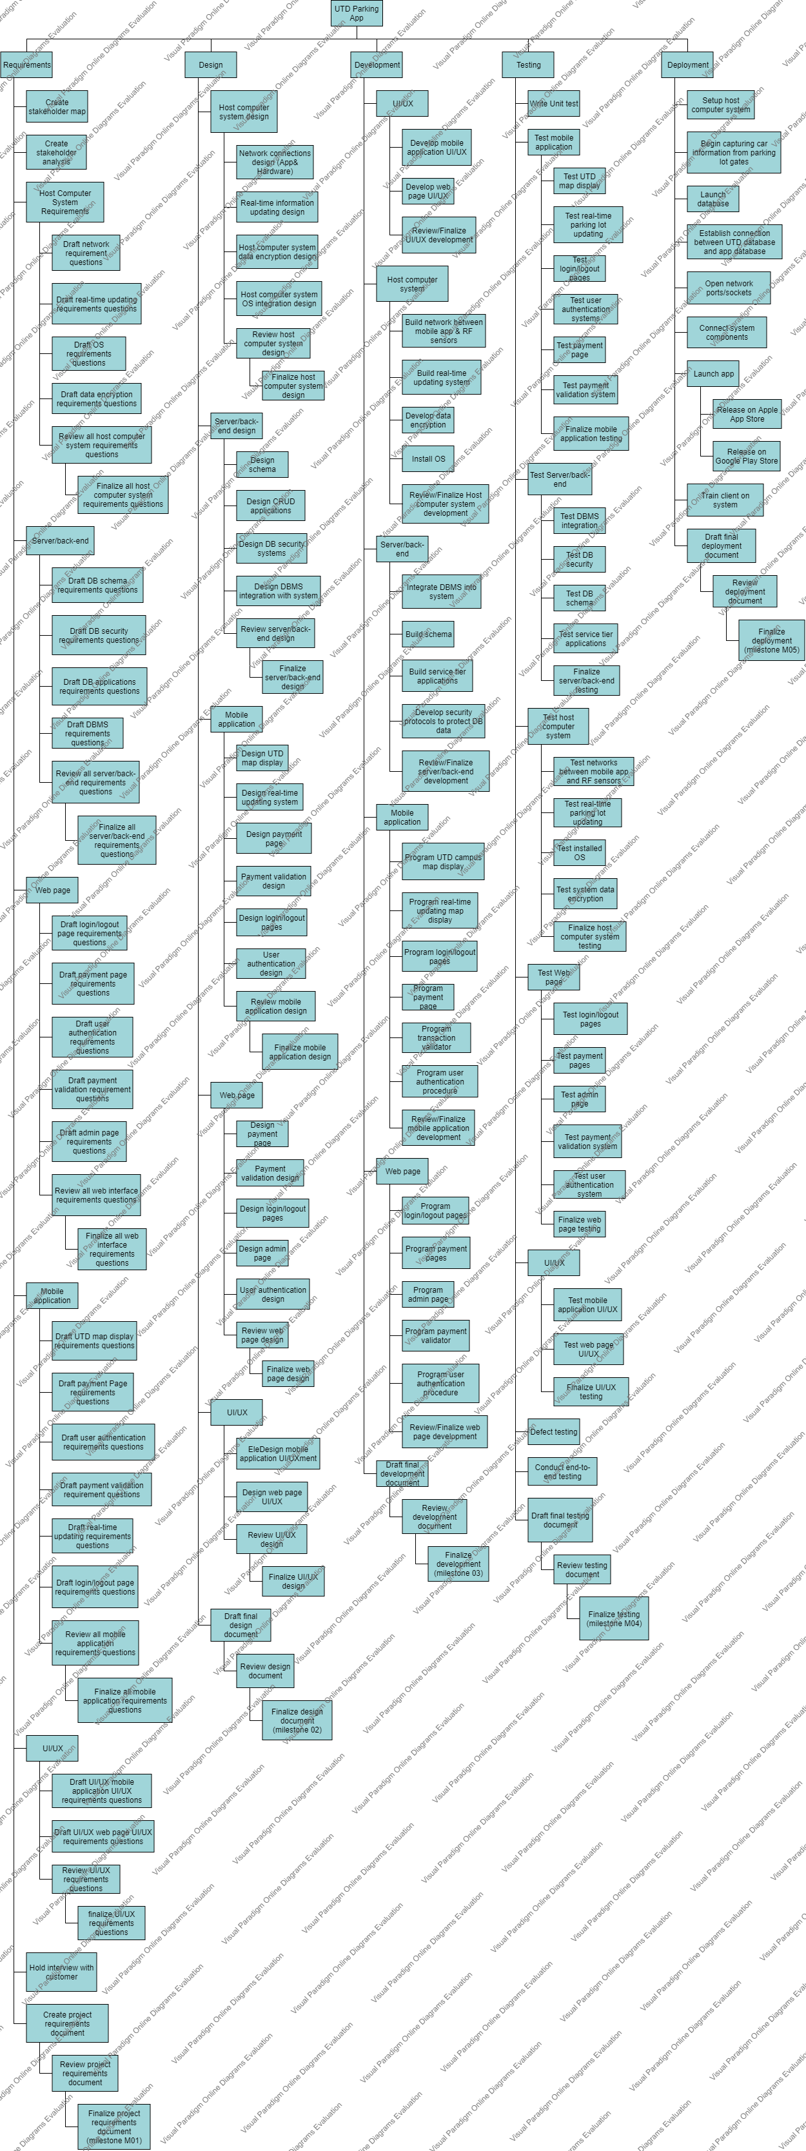
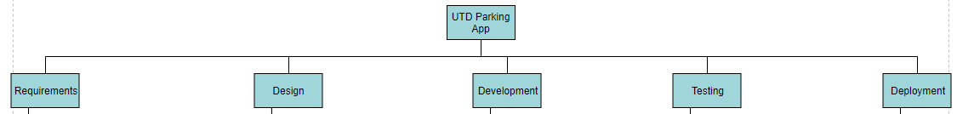
Work Breakdown Structure
Broken down into 5 stages of software lifecycle
Requirements, Design, Development, Testing, Deployment

Slide 7
WBS: Requirements
Mobile app
Web page
Server/back-end
Host computer system
UI/UX
Get information about what the client wants out of the system
Broken down into functional areas

Slide 8
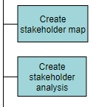
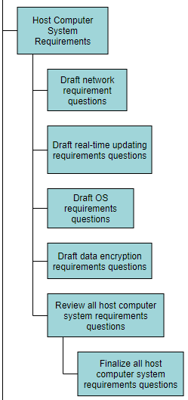
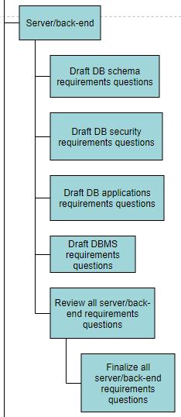
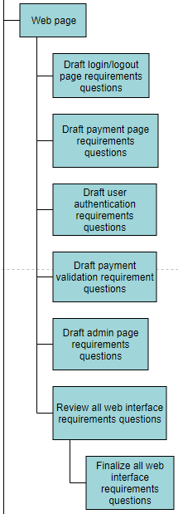
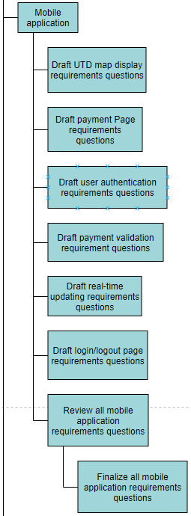
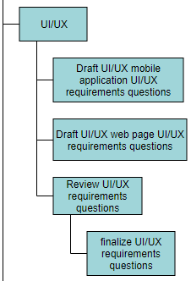
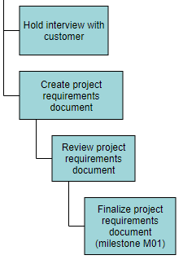
WBS: Requirements

Slide 9
WBS: Design
Host comp. system
Mobile app
UI/UX
Server/back-end
Web page
Design what is important to end users
Design essential architecture for system to work

Slide 10
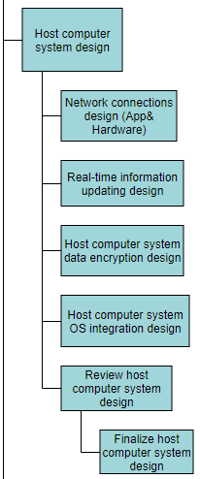
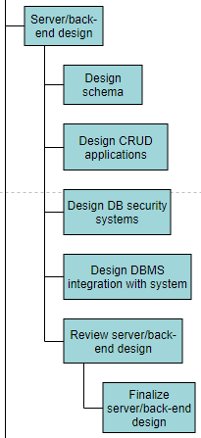
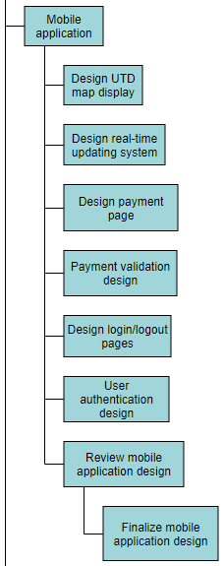
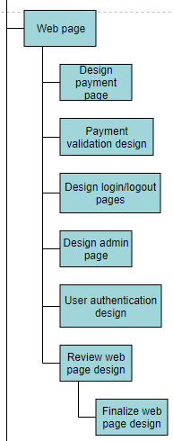
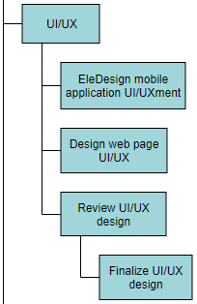
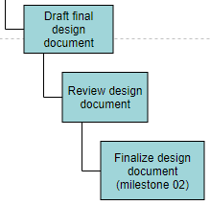
WBS: Design

Slide 11
WBS: Development
Host computer system
Web page
Server/back-end
Mobile app
UI/UX
Find parts that need to be built
Determine which functionalities they need
Adherence to requirements

Slide 12
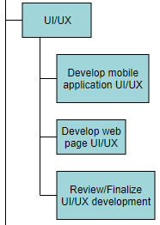
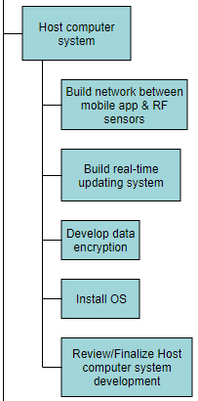
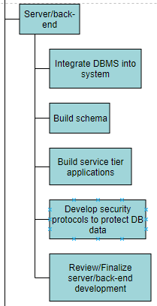
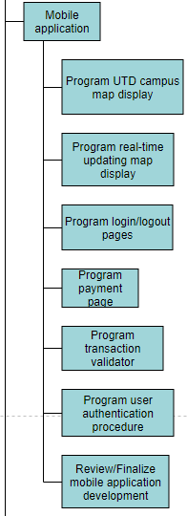
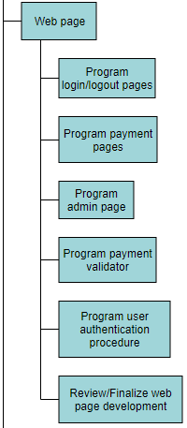
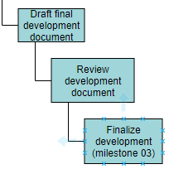
WBS: Development

Slide 13
WBS: Testing
UI/UX
Host computer system
Server/back-end
Web page
Mobile app
Unit tests, end-to-end tests, error detection
Find any issues with the system
Ensure system is secure
Ensure system won’t collapse under high usage

Slide 14
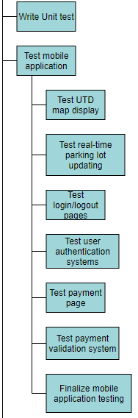
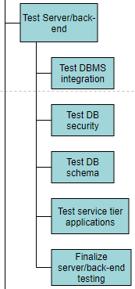
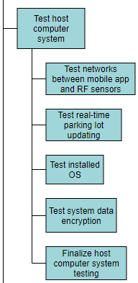
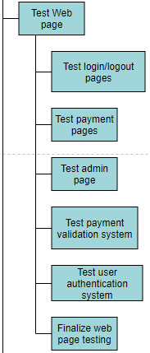
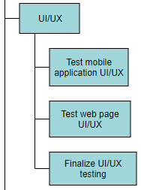
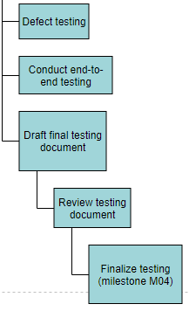
WBS: Testing

Slide 15
WBS: Deployment
Launch app
Connect UTD database and app database/launch new database
Host computer system setup
Establish network connections
Training
Launch DB
Ensure everything is in place for launch day
All systems connected together
Make sure users have functionality

Slide 16
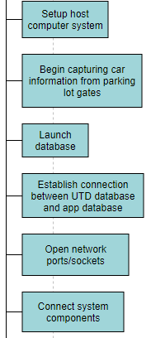
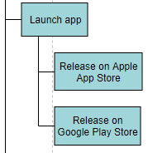
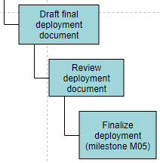
WBS: Deployment

Slide 17
Pricing Milestones
Wages based of average of appropriate engineering position in Dallas, TX
Development costs mostly come from back-end, host computer system, and mobile application development
Time to build estimated around 270 days
Based on average length of medium-sized software project
Milestone | Price(USD)
Requirements (M01) | $100,000
Design (M02) | $200,000
Development (M03) | $800,000
Testing (M04) | $400,000
Deployment (M05) | $150,000
Total: | $1,650,000
Initial top-down estimate

Slide 18
Pricing Milestones
1.35 mark-up
Time to build less than original estimate (198 days)
Development cost drastically overestimated prior
Includes employee benefits
Team of 41 employees
Including PM
Milestone | Price(USD)
Requirements | $117,819
Design | $83,060
Development | $264,632
Testing | $247,452
Deployment | $108,272
Total: | $811,760
Milestone | Price(USD)
Requirements | $159,055
Design | $112,131
Development | $358,765
Testing | $310,506
Deployment | $146,167
Total: | $1,086,624
Bottom up cost
Bottom up price

Slide 19
Key Risks & Issues
Risks:
Drafting of final testing document may run over budget by 14% due to Testing Engineer Lead demanding larger salary. This may cause the testing phase to go cash flow negative as well as make the review and finalization of the testing document (milestone 04) run over budget.
Launch of database may be late due by 2 days to Deployment Engineer 3 being new to the project and inexperienced with workload. This may cause the connection of the system components to be late.
Issues:
Testing of service tier applications not finished on time due to testing equipment/supplies arriving later than expected. This has caused the finalization of server/back-end document to become late.
Review of the development document (milestone 03) is one week late on delivery due to Development Engineer Lead unexpectedly contracting the flu. This has caused the finalization of the development document (milestone 03) to go past deadline by 3 days.

Slide 20
Decisions & Actions
Decisions:
UTD database administrator and UTD network administrator shall be present when deployment team is connecting system together.
Testing Engineer 12 will act as a stand-in for the Testing Engineer Lead during the Drafting, Review, and Finalization of the testing phase document.
Actions:
Testing Engineer Lead has decided to sit-in on some of the workload conducted by Testing Engineer 3 and provide training for tasks that she does not have much experience with
A new Deployment Engineer shall be brought in from another project within the company as a fill-in until a suitable replacement has been found
Deployment Engineer Lead shall contact UTD upper management in order to get a location on where the host computer system shall be installed at
Deployment Engineer Lead shall keep UTD database administrator up-to-date about the launch of the database when it is time for database to be deployed

Slide 21
RMP Flowchart
Will it affect scope, budget, or schedule if it occurs?
NO
Submit potential risk
Project manager evaluation
Not a risk
start
YES
Tentatively place risk in RAID sheet
Set up meeting with person(s) who submitted risk
Set up meeting with team lead who leads the project phase in which the risk was detected
Does task have schedule slack to compensate for risk delaying delivery?
Associate risk with specific project task

Slide 22
Have employee(s) working on task come in on weekends to finish task on time
Monitor risk daily and receive updates from team where risk originated
Update RAID sheet with severity, mitigation, and contingency
Set up meeting with team where risk originates from to brainstorm mitigations/ contingencies
Does task have schedule slack to compensate for risk delaying delivery?
Have employee(s) working on task to work extra 2 hours each weekday to ensure task finishes on time
Monitor risk weekly by getting updates from the team lead responsible for the at-risk task(s)
HIGH
(>40%)
Set up meeting with team where risk originates from to brainstorm mitigations/ contingencies
Update RAID sheet with severity, mitigation, and contingency
What is the probability of the risk occurring?
NO
MEDIUM
(15%< x <40%)
LOW
(<15%)
Have employee(s) working on task to work 2 extra hours each week to ensure task finishes on time
Monitor risk bi-weekly by getting updates from the team lead responsible for the at-risk task(s)
YES
Project manager should brainstorm mitigations/ contingencies for risk
Update RAID sheet with severity, mitigation, and contingency
Would the risk make the task go over its predicted budget?

Slide 23
Monitor risk daily and receive updates from team where risk originated weekly
Monitor risk daily and receive updates from team where risk originated weekly
Would the risk make the task go over its predicted budget?
Cut back resources working on task by 65%
Cut back all superfluous resources working on task
Update RAID sheet – add severity, mitigation, and contingency
YES
Update RAID sheet – add severity, mitigation, and contingency
Cut back resources working on task by 30%
Monitor risk weekly and receive updates from team where risk originated bi-weekly
HIGH >45%
Update RAID sheet – add severity, mitigation, and contingency
NO
What percentage does the task go over budget?
YES
Does the risk make the project go cash flow negative?
MEDIUM 25%< x 45%
NO
LOW <25%
Monitor risk monthly and receive updates from team where risk originated monthly
Update RAID sheet – add severity, mitigation, and contingency
Cut back resources working on task by 10%
Does the risk change the project/task scope?

Slide 24
Update RAID sheet – add severity, mitigation, and contingency
Have working team email PM updates weekly to monitor the development of the risk
Does the risk change the project/task scope?
Edit PMP to account for change in scope
Allocate additional 25% of necessary resources to task
YES
Hold meeting with Requirements Engineer team lead
HIGH >25%
Have working team email PM updates bi-weekly to monitor development of risk
Have working team come in on weekends to make up for additional work
Update RAID sheet – add severity, mitigation, and contingency
Edit PMP to account for change in scope
How much work does this risk add to the task?
MEDIUM
10% < x < 25%
NO
LOW >10%
Have working team spend 2 hours overtime on weekdays to account for additional work
Have working team email PM updates monthly to monitor development of risk
Update RAID sheet – add severity, mitigation, and contingency
Edit PMP to account for change in scope
Continue to monitor and mitigate risks until they are resolved

Slide 25
RMP Table
Flow Step | Flow Step
Submit potential risk | A risk is generated from a team member or project manager. Risk is forwarded to the project manager for further evaluation
Project manager evaulation | Project manager will look over the submitted risk and evaluate it to determine if the risk poses a threat to changing either the scope, budget, or schedule of the project overall
Will it affect scope, budget, or schedule if it occurs? | Project manager must determine if the submitted risk has the chance of changing the scope, budget, or schedule of the project in any way if it were to take place.
Not a risk | The project manager has determined that the submitted risk cannot/will not affect the scope, budget, or schedule of the project in any form. If there scope, budget, or schedule is not affected, than the submitted risk is not actually a risk.
Tentatively place risk in RAID sheet | List the risk in the RAID sheet but do not give it a severity rating yet. Project manager will gather more information about the risk and its owner(s) before filling out RAID sheet
Set up meeting with person(s) who submitted risk | Talk to the person who originally submitted the risk to get more details about the risk. In this meeting, get the following information: issues leading to risk creation, probability of risk occuring, cost impact of risk, schedule impact of risk, and scope impact of risk.
Set up meeting with team lead who leads the project phase in which the risk was detected | Meeting with the appropriate team lead should include talking about the nature of the risk (schedule risk, budget risk, scope risk) and going over what strategies are being used to counteract the risk. Team lead should provide an updated probability of the risk occuring, risk's impact on the budget, and scope change percentage.
Associate risk with specific project task | Specify which task in the project schedule that the risk originates from and update RAID sheet with information
Does task have schedule slack to compensate for risk delaying delivery? | Project manager should determine whether or not the task that the risk is associated with is on the critical path according to the project schedule.
Set up meeting with affected team to brainstorm solutions | Get the team who is responsible for the at-risk task together and come up with mitigation plans that will resolve the risk before it becomes an issue.
Update RAID sheet with severity, mitigation, and contingency | Project manager will go back to RAID sheet and fill out remaining information that was not gathered the first time.
Initiate mitigation plan to prevent risk from turning into issue | Put the mitigation plan into affect immediately in order to prevent risk from happening. Inform affected people of this decision.
Monitor risk daily and receive updates from team where risk originated | Ensure that the risk is not turning into an issue by keeping an eye on how the at-risk task is developing. Team that risk is affecting should email project manager weekly with status updates regarding the risk until the risk has been fully mitigated.
Set up meeting with affected team to brainstorm solutions | Get the team who is responsible for the at-risk task together and come up with mitigation plans that will resolve the risk before it becomes an issue.
Update RAID sheet with severity, mitigation, and contingency | Project manager will go back to RAID sheet and fill out remaining information that was not gathered the first time.
Monitor risk weekly by getting updates from the team lead responsible for the at-risk task(s) | Ensure risk is being monitored and kept under controll by checking up with the team lead for which ever phase the at-risk task is in (i.e. development team lead if the at-risk task is related to the development of the project). A regular 30+ minute talk should be had where the team lead explains what he/she is doing to mitigate the risk.
Project manager should brainstorm mitigations/ contingencies for risk | Project manager should forumlate solutions to risk that will mitigate the risk without putting another task at risk.

Slide 26
Update RAID sheet with severity, mitigation, and contingency | Project manager will go back to RAID sheet and fill out remaining information that was not gathered the first time.
Monitor risk bi-weekly by getting updates from the team lead responsible for the at-risk task(s) | Ensure that the risk is being monitored and does not become a greater risk. Updates received from team lead should include a status of the at-risk task.
Would the risk make the task go over its predicted budget? | Project manager should look at the estimated budget in their project plan to determine if the at-risk task in going over that predicted amount.
Does the risk make the project go cash flow negative? | Project manager should look calculate the cost of other tasks happening concurrently to at-risk task as well as how much is expected to be paid for the delivery of the milestone to determine if the at-risk task sends the project to a negative cash flow.
Cut back on superfluous resources working on task | Assign all non-essential resources on at-risk task to other tasks that need to be worked on.
Update RAID sheet – add severity, mitigation, and contingency | Record risk on the RAID sheet and add its severity (high), mitigation plan, and contingency plan.
Monitor risk weekly and receive updates from team where risk originated | Make sure employee(s) working on at-risk task update project manager weekly about the budget of the task. Project manager should use these costs forecast the project budget and make adjustments to the project plan.
How much does the task go over its assigned budget? | Determine a numerical impact to the project budget that the risk would cause if it turned into an issue.
Update RAID sheet – add severity, mitigation, and contingency | Project manager will update the RAID sheet so that the risk has the appropriate severity associated with it (high) as well as a mitigation and contingency plan.
Cut back resources working on task by 50% | Take away 65% of the resources currently working on the assignment and allocate them to other tasks.
Monitor risk daily and receive updates from team where risk originated weekly | Project manager should check the risk daily to make sure task does not go over budget. The team working on the task should provide detailed breakdown of what part of the budget was spent to accomplish the task.
Update RAID sheet – add severity, mitigation, and contingency | Project manager will update the RAID sheet so that the risk has the appropriate severity associated with it (medium) as well as a mitigation and contingency plan.
Cut back resources working on task by 30% | Take away 30% of the resources currently working on the assignment and allocate them to other tasks.
Monitor risk weekly and receive updates from team where risk originated bi-weekly | Project manager should check risk weekly to ensure it does not turn into an issue. The team working on the task should provide detailed breakdown of what part of the budget was spent to accomplish the task.
Update RAID sheet – add severity, mitigation, and contingency | Project manager will update the RAID sheet so that the risk has the appropriate severity associated with it (low) as well as a mitigation and contingency plan.
Cut back resources working on task by 10% | Take away 10% of the resources currently working on the assignment and allocate them to other tasks.
Monitor risk monthly and receive updates from team where risk originated monthly | Project manager should check risk monthly to ensure that it is mitigated before moving on to new tasks. The team working on the task should provide detailed breakdown of what part of the budget was spent to accomplish the task.
Does the risk change the project/task scope? | With the information provided from both the person who submitted the risk and the team lead who has jurisdiction over the task in which the risk was spotted, decide if the risk changes any part of the project or task's scope.
Hold meeting with Requirements Engineer team lead | Discuss risk further with Requirements Engineer Lead to determine what impact on the project's/task's scope this risk has. In this meeting, determine how much of a change in scope percentage this risk poses.
How much work does this risk add to the task? | Project manager should determine what percentage of work the risk may add to the at-risk task based upon the information provided by the Requirements Engineer Lead.
Update RAID sheet – add severity, mitigation, and contingency | Project manager will update the RAID sheet so that the risk has the appropriate severity associated with it (high) as well as a mitigation and contingency plan.
Edit PMP to account for change in scope | Project manager will report change in scope on the PMP so that its permanently recorded and available for reference.
Allocate additional 25% of necessary resources to task | Ensure that the additional workload is met with additional resources to ensure task is completed on time.

Slide 27
Have working team email PM updates weekly to monitor the development of the risk | Make sure that team responsible for working on at-risk task keeps project manager up to date with developments with the task.
Update RAID sheet – add severity, mitigation, and contingency | Project manager will update the RAID sheet so that the risk has the appropriate severity associated with it (medium) as well as a mitigation and contingency plan.
Edit PMP to account for change in scope | Project manager will report change in scope on the PMP so that its permanently recorded and available for reference.
Have working team come in on weekends to make up for additional work | Have the working team come in on weekends until all additional work is completed so that resources are not taken away from other tasks.
Have working team email PM updates bi-weekly to monitor development of risk | Make sure that team responsible for working on at-risk task keeps project manager up to date with developments with the task.
Update RAID sheet – add severity, mitigation, and contingency | Project manager will update the RAID sheet so that the risk has the appropriate severity associated with it (low) as well as a mitigation and contingency plan
Edit PMP to account for change in scope | Project manager will report change in scope on the PMP so that its permanently recorded and available for reference.
Have working team spend 2 hours overtime on weekdays to account for additional work | Working team should spend additional hours working on at-risk task so that schedule is maintained and delivery of project is not delayed
Have working team email PM updates monthly to monitor development of risk | Make sure that team responsible for working on at-risk task keeps project manager up to date with developments with the task.
Continue to monitor and mitigate risks until they are resolved | All risks should be continued to monitored and actively mitigated in order to ensure that they do not turn into issues and affect the scope, budget, or schedule of the overall project.

Slide 28
UTD upper management
Mohammad Asif, Everett McCrea, Luke Padgett
Purchasing / procurement department
UTD network administrator(s)
Internal upper management
Level 1
UTD IT department
UTD database administrator
Hardware development manager
Level 2
Level 3
Requirements team
Deployment team
Design team
Internal project manager
Level 4
Testing/QA team
Development team

Slide 29
Development team
Internal project manager
Internal upper management
Testing/ QA team
Design Team
Requirements team
Deployment Team
Power
Keep satisfied
Manage closely
Monitor
Keep informed
Hardware development manager
UTD IT department
Purchasing/ procurement department
UTD network administrators
UTD database administrator
UTD upper management
Influence

Slide 30
Internal project manager: KLY Inc. project manager responsible for keeping project on budget, schedule, and scope. Responsible for drafting the Statement of Work and for discussing project matters with KLY Inc. upper management. Internal employees should meet with him face-to-face or send an email to discuss topics relating to the project. External parties should send an email.
Design Team: Team in charge of creating and enforcing the design patterns and blueprints that shall be used during the development of the UTD Parking Availability App Project. Design Engineer Lead should be contacted via email first before establishing any face-to-face meeting.
Development team: Team in charge of creating the codebase for which the UTD Parking Availability App will run off of. This team is responsible for both front-end and back-end of the project while following the design laid out by design team. Development Engineer Lead can either reached via email or voicemail.
Testing/ QA team: Team responsible for testing the codebase created by the development team. Determines which functionalities are working as intended and which are not. Reports back to development team each week with bug findings. Testing Engineer 12 should be contacted first via phone call or email before going to Testing Engineer Lead.
Requirements team: Team that collects the requirements from the customer (UTD) and interprets the requirements for the design, development, testing, and deployment teams. Customers should contact Requirements Engineer Lead via phone call. Internal employees may meet with Requirements Engineer Lead any weekday after 6:00 PM at her office.
Deployment Team: Team responsible for connecting all the developed systems together and delivering final project to customer. Deployment team members should work closely with customer’s IT department and database administrator to ensure seamless integration of system into customer’s technological infrastructure. Deployment Team Lead should be reached via phone call on Tuesdays and Wednesdays, and email every other weekday.
UTD IT department: IT department at UTD responsible for ensuring maintenance of UTD systems and services. UTD IT department should be made aware of any decisions involving the technology used by the system. Contact either the UTD IT help desk or send email to IT department representative Carl Smith at email cfm150430@utdallas.edu.

Slide 31
UTD database administrator: Administrator of the UTD student records database. Determines which applications will be allowed access to the UTD database and has full autonomy over changes made to student records schema design. Communication should be limited to phone calls, video calls, and emails only.
UTD network administrators: Manager of the UTD network and determines which devices/systems are permitted access to UTD bandwidth. Is available to meet each Friday from 3:00 to 7:00 PM.
UTD upper management: Primary sponsors of the UTD Parking Availability App Project. Upper management includes University president, dean of undergraduate learning, dean of graduate learning, and president of bursar office. Communication limited to meetings that agree with everyone’s schedule.
Internal upper management: KLY Inc. upper management and direct supervisor of internal project manager. Responsible for funding project. Can be reached by emailing his assistant any time during the work week.
Hardware development manager: Manager responsible for ensuring the development of the gate infrastructure goes along smoothly. Will communicate with the internal project teams to pass along information about how the gate infrastructure functions and how it should be use to develop the app. Available for meeting every Monday, Tuesday, and Friday form 12:00 – 2:30 PM.
Purchasing/ procurement department: Internal department that is responsible for placing all orders on required equipment for KLY Inc. projects. Should resources need to be purchased for a project, representative must be contacted at least one month in advance. Can set up a meeting with department representative any time during the weekdays.

Slide 32
Mohammad Asif, Dylan Capece, Blake Stroud
Stakeholder | Method of communication | Days Available | Times | Subjects | Description
Internal project manager | email, meeting | M | W | F | Sa | 6:00 AM – 5: 00 PM | Risks, issues, conflicts, estimations, change requests, project updates, schedule forecast, | Project manager is point of contact for all external contacts and customers. All customer queries and project status updates should be directed to project manager first.
Design Team | email, meeting | M | Tu | W | Th | F | 8:00 AM – 5:00 PM | Mitigation strategies, risks, issues, schedule changes, resource allocation, meeting times | Design Engineer Lead is point of contact for entire design team. Should information received be intended for specific design team member, Design Engineer Lead shall inform/forward that information to the employee.
Development team | email, voicemail, meeting | M | Tu | W | Th | F | 8:00 AM – 5:00 PM | Mitigation strategies, risks, issues, schedule changes, resource allocation, meeting times | Development Engineer Lead is point of contact for the entire development team. Information regarding bug fixes should be provided each week. Should information received be intended for specific design team member, Design Engineer Lead shall inform/forward that information to the employee.
Testing/ QA team | email, phone call | M | Tu | W | Th | F | 8:00 AM – 5:00 PM | Mitigation strategies, risks, issues, schedule changes, resource allocation, meeting times | Testing Engineer Lead is point of contact for the entire development team. Development Engineer Lead shall contact testing team with bug fixes made each week. Should information received be intended for specific design team member, Design Engineer Lead shall inform/forward that information to the employee.
Requirements team | meeting, email, phone call | M | Tu | W | Th | 10:00 AM – 4:00 PM | Mitigation strategies, risks, issues, schedule changes, resource allocation, meeting times | Requirements Engineer Lead is point of contact for entire requirements team. Any changes in requirements or customer interviews should be communicated as soon as possible. Should information received be intended for specific design team member, Design Engineer Lead shall inform/forward that information to the employee.

Slide 33
Stakeholder | Method of communication | Days Available | Times | Subjects | Description
Deployment Team | email, meeting, phone call | M | Tu | W | Th | Sa | 8:30 AM – 3:30 PM | Mitigation strategies, risks, issues, schedule changes, resource allocation, meeting times | Deployment Engineer Lead is point of contact for deployment team. Any issues with installation dates or customer meetings should be reported immediately. Should information received be intended for specific design team member, Design Engineer Lead shall inform/forward that information to the employee.
UTD IT department | Email, meeting | M | Tu | W | Th | F | Sa | Su | 9:00 AM – 4:00 PM | Technical queries, meeting times | Representative from the UTD IT department is selected as the point of contact for the project team to communicate with (cfm150430@utdallas.edu). Should any questions regarding the architecture or the UTD systems be needed, they should be forwarded here.
UTD database administrator | email | M | Tu | W | F | 9:30 AM – 4:30 PM | Technical queries, schema design questions | Key figure in determining what systems have access to UTD student information database. Development and deployment teams should communicate with DBA whenever information about the structure of the database is needed.
UTD network administrators | Email, video meeting | M | Tu | W | Th | F | 9:30 AM – 4:30 PM | Technical questions, port information | Key figure in determining what systems have access to the UTD networks. Development and deployment teams should establish communication whenever information about network design is needed.
UTD upper management | Meeting, email, video meeting, phone call | M | W | Sa | Su | 12:00 AM – 3:00 PM or by appointment | Project requirements questions, schedule questions, meeting times, project status reports | People in charge of paying for the project. Information regarding changes in overall project delivery schedule should be communicated to this party as soon as possible.

Slide 34
Stakeholder | Method of communication | Days Available | Times | Subjects | Description
Internal upper management | Email, voicemail | Th | F | Sa | 1:00 PM – 2:00 PM or by appointment | Meeting times, changes in schedule, budget impacts, issues, changes in scope, project status reports. | Supervisor of entire project. Responsible for allocating funds to the project and is key factor in determining which projects are taken on. Project manager should communicate major issues with the project to the internal upper management when they arise.
Hardware development manager | Meeting, phone call | M | Tu | Th | F | 3:00 PM – 6:00 PM | Meeting times, project development reports, technical queries | Responsible for overseeing the development of gate hardware. Communication should be established between Development Team to ensure that codebase is developed to work properly with chosen hardware.
Purchasing/ procurement department | Meeting | W | Th | F | Sa | 7:00 AM – 5:00 PM | Meeting times, purchase requests | Party responsible for obtaining necessary equipment needed to complete project tasks. Meeting should be established early in project life cycle to ensure timely delivery of equipment.

Slide 35
Lessons Learned
Slide updated by Everett McCrea
(1,2) Everett McCrea, (3, 4) Luke Padgett, (5, 6) Mohammad Asif, (7,8) Blake Stroud, (9, 10) Dylan Capece
1. Risks are something that could go wrong - not something that has gone wrong
Risks point out complications that have the potential to impact the budget, schedule, or scope of a project; issues are complications that have already affected the project. For an issue to occur, there must have been a risk that was not mitigated properly.
2. Project tasks should be laddered in order to break down work into multiple, smaller tasks.
Having tasks on the project schedule be laddered as much as possible can help reduce the duration of the project by having some tasks start earlier than originally planned. Our project schedule was not originally laddered well, and it caused us to have a schedule that was about 250 days long. After extensive laddering, we were able to make the schedule only 198 days long.
3. The governance plan should describe in detail what should occur as well as the reasons for its occurrence and the results of said occurrence.
With a detailed governance plan, a broad overview of all project management activities can be produced whenever necessary in the form of this governance plan. It can serve as guidelines for any scheduled events so the project manager can focus the meeting.
4. The MPP should be made with great care so that certain resources (human or otherwise) are not “stretched thin,” so to speak.
Upon creating an MPP, it is wise to consider who (i.e. which developer, which tester, etc) is working on what task and how many other tasks they are working on during a given time. If a resource is working on too many tasks at once this is not ideal, so it is a better idea to spread out more resources across more tasks to adequately distribute work.

Slide 36
Lessons Learned
Slide updated by Everett McCrea
5. PMP can be looked at as a process of harnessing a “wild” idea and making it visually trackable and objectively controllable.
A process of repeatedly breaking down one whole, putting the broken parts into a structure, and making it a totally different whole- where the difference is as wide as an abstract SOW and a “concrete-like” Dashboard- requires a great deal of attention to details. Producing the right product requires the right feeding.
6. Risks are inherent to the projects, projects are managed in a dynamic environment, so the “dynamicity” needs to be taken into account while developing RMPs.
Risks can originate from anywhere; their origins should be determined precisely and their effects should be assessed carefully. Risks probably can be categorized as operational, managerial, internal, external, and environmental. Dealing with Risks (threat), with external or environmental origins, maybe beyond the ability and responsibility of a PM. But despite that it would be a good practice/idea to be proactive and formulate SOW and its related sections so that the organization cannot be held accountable (due to lawsuit or litigation put forward by customer) in the case of project delay/failure.
7. Risks need to be tied to a specific task on the MPP and describe how they might impact future tasks.
Without a specific task being referenced, it becomes difficult to think of a mitigation plan for a risk. Additionally, contingencies become difficult to form if a risk does not list which task(s) could be impacted in the future.
8. The Statement of Work defines what the project plans to accomplish as well as some of the key deliverables of said project.
The statement of work serves as a contract between the company and the customer as a detailed list of what work should be accomplished, when it should be accomplished by, how much it should cost, and the customer responsibilities.
9. Risk severity should be determined by using the risk management plan flow chart by evaluating its potential impact to scope, cost, or schedule.
Evaluating a risk with a risk management plan flow chart allows the project manager to gain a better understanding of how a risk could impact a project if it turns into an issue.
10. Bottom-up budget estimates are much more accurate at predicting the project cost than top-down estimates.
Bottom-up budget estimates evaluate the cost of each work package in the work breakdown structure and allows the project manager to gain a better understanding of how much each phase of the project will cost.

